Slide 1
MariSynFuel
Synthetic green methanol as maritime fuel for shipping „Made in Bremerhaven“
A lighthouse project for the maritime sector in Germany – strengthening the scientific and port location Bremerhaven!
Prof. Dr.-Ing. Gerhard Schories
-Head of Institute ttz Bremerhaven -

Slide 2
MariSynFuel – Synthetitic green methanol for shipping „Made in Bremerhaven“
Core elements of the project:
Development and implementation of a plant for production of green synthetic methanol at demonstration scale
Final production capacity 500 kg/d
Direct application for fueling the new built research vessel Uthörn of AWI
Timeline:
01.01.2023 – Start of the project
End of 2025 - Production of synthetitic green methanol „Made in Bremerhaven“ for direct application in the research vessel Uthörn
31.12.2026 – End of the project
Consortium:

Slide 3
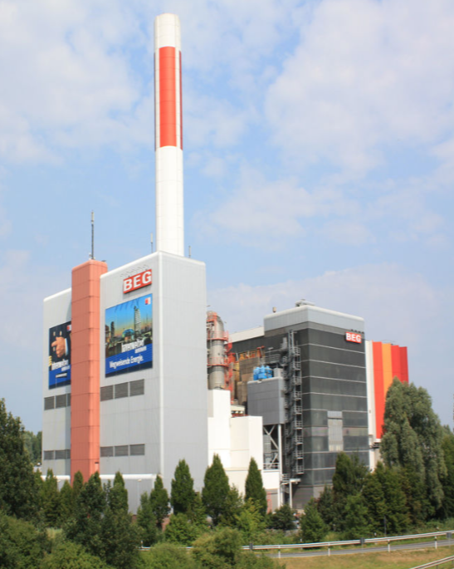
MariSynFuel – Synthetitic green methanol for shipping „Made in Bremerhaven“
Leuchtturmprojekt für den maritimen Sektor in Deutschland - Stärkung des Wissenschafts- und Hafenstandorts Bremerhaven
Targets:
Production of hydrogen based synthetic fuels in Bremerhaven in avoiding CO2 emissions from fossil fuels.
Implementation of a sustainable value chain in Bremerhaven involving local industry and institutes
Quelle: Diersch & Schröder
Renewable electricity/
exhaust gases
green H₂ recovered CO₂
Methanol synthesis
Storage & bunkering
Application

Slide 4
MariSynFuel – Synthetitic green methanol for shipping „Made in Bremerhaven“
Project Funding:
»The porject MariSynFuel is funded in the frame of the concept Renewable Fuels with 6.586.425 Euro in total by the Federal Ministry for Digital and Transport. The guideline for development of regenerative fuels in coordinated by NOW GmbH and is implemented by the agencies VDI/VDE Innovation + Technik GmbH and Fachagentur Nachwachsende Rohstoffe e. V..«

Slide 5
Prof. Dr.-Ing. Gerhard Schories
Phone: +49 471 80930 -102
geschories@ttz-bremerhaven.de
ttz Bremerhaven
Am Lunedeich 12
27572 Bremerhaven
Germany
info@ttz-bremerhaven.de
www.ttz-bremerhaven.de

