Slide 1
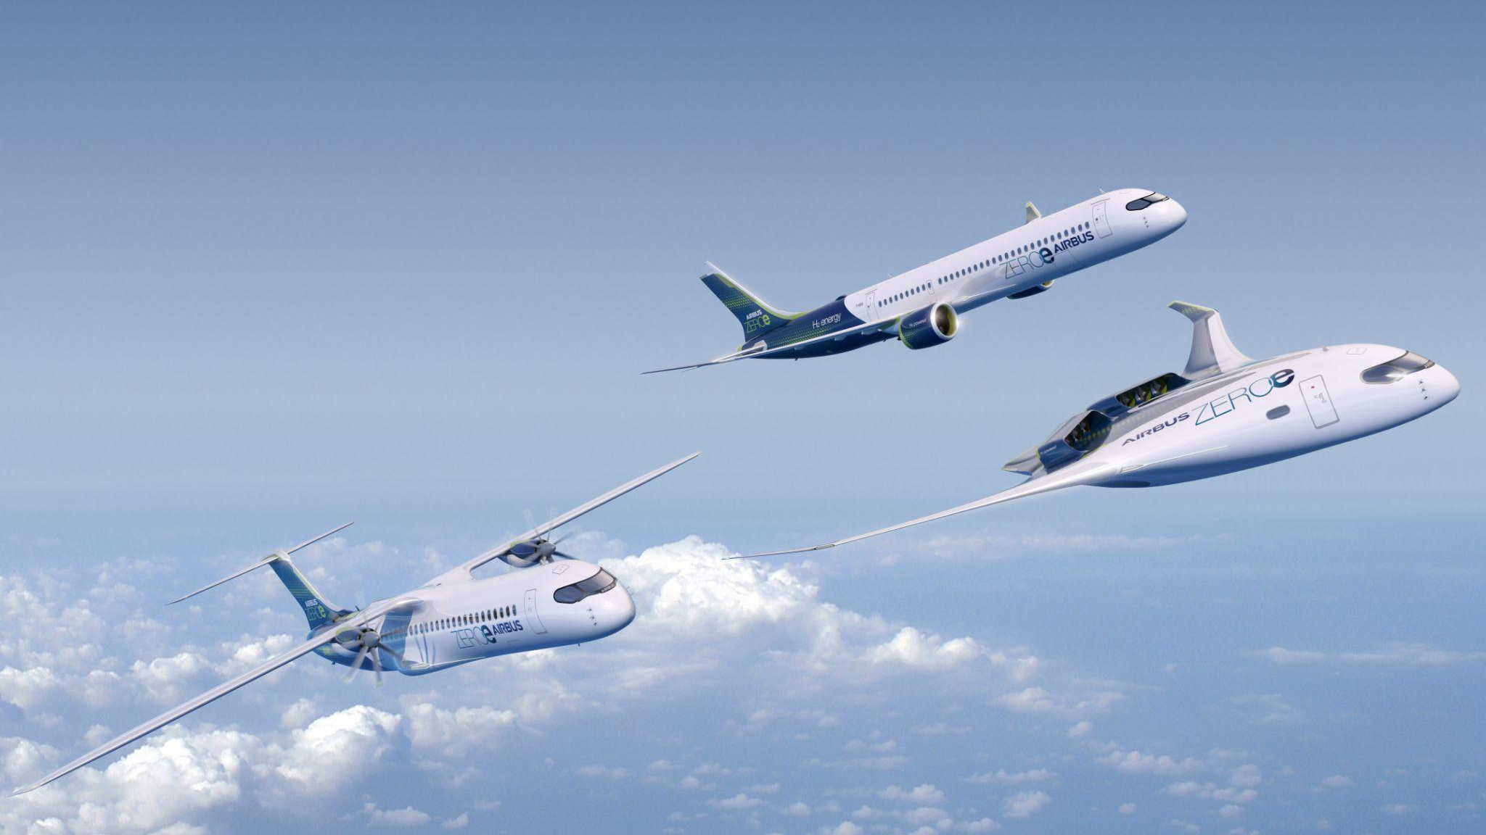
AIRBUS AMBER
ZEROe Aircraft
Introducing ZEDC
ZEDC LH2 Tanks
Matthias HOLZWARTH | Loïc BUFFET
2023 - June 19th to 23th

Slide 2
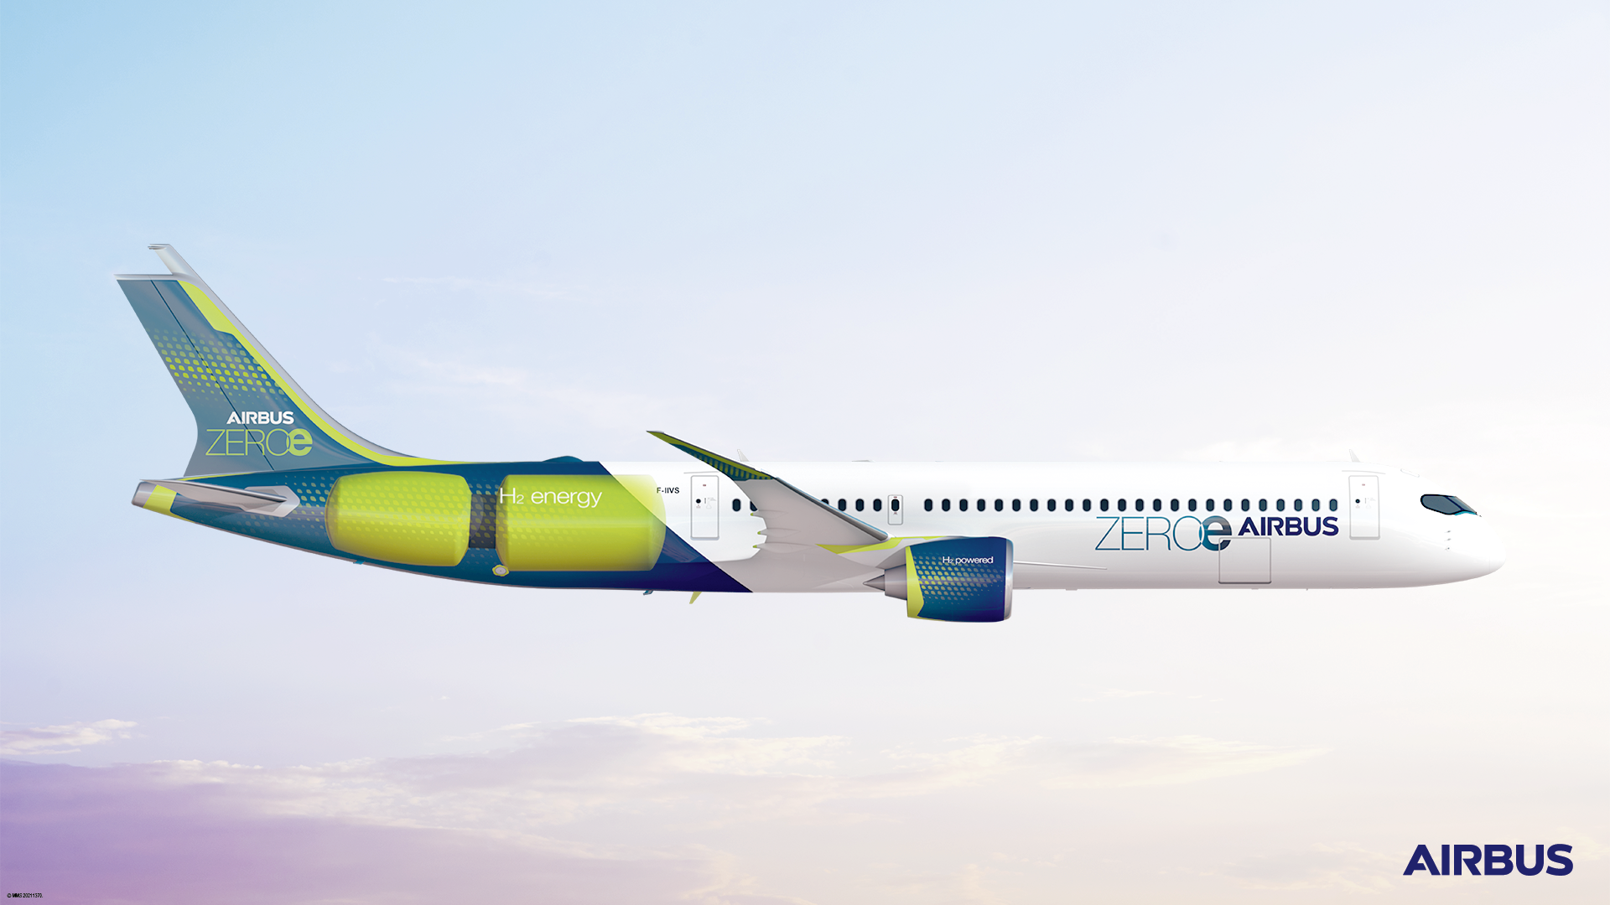
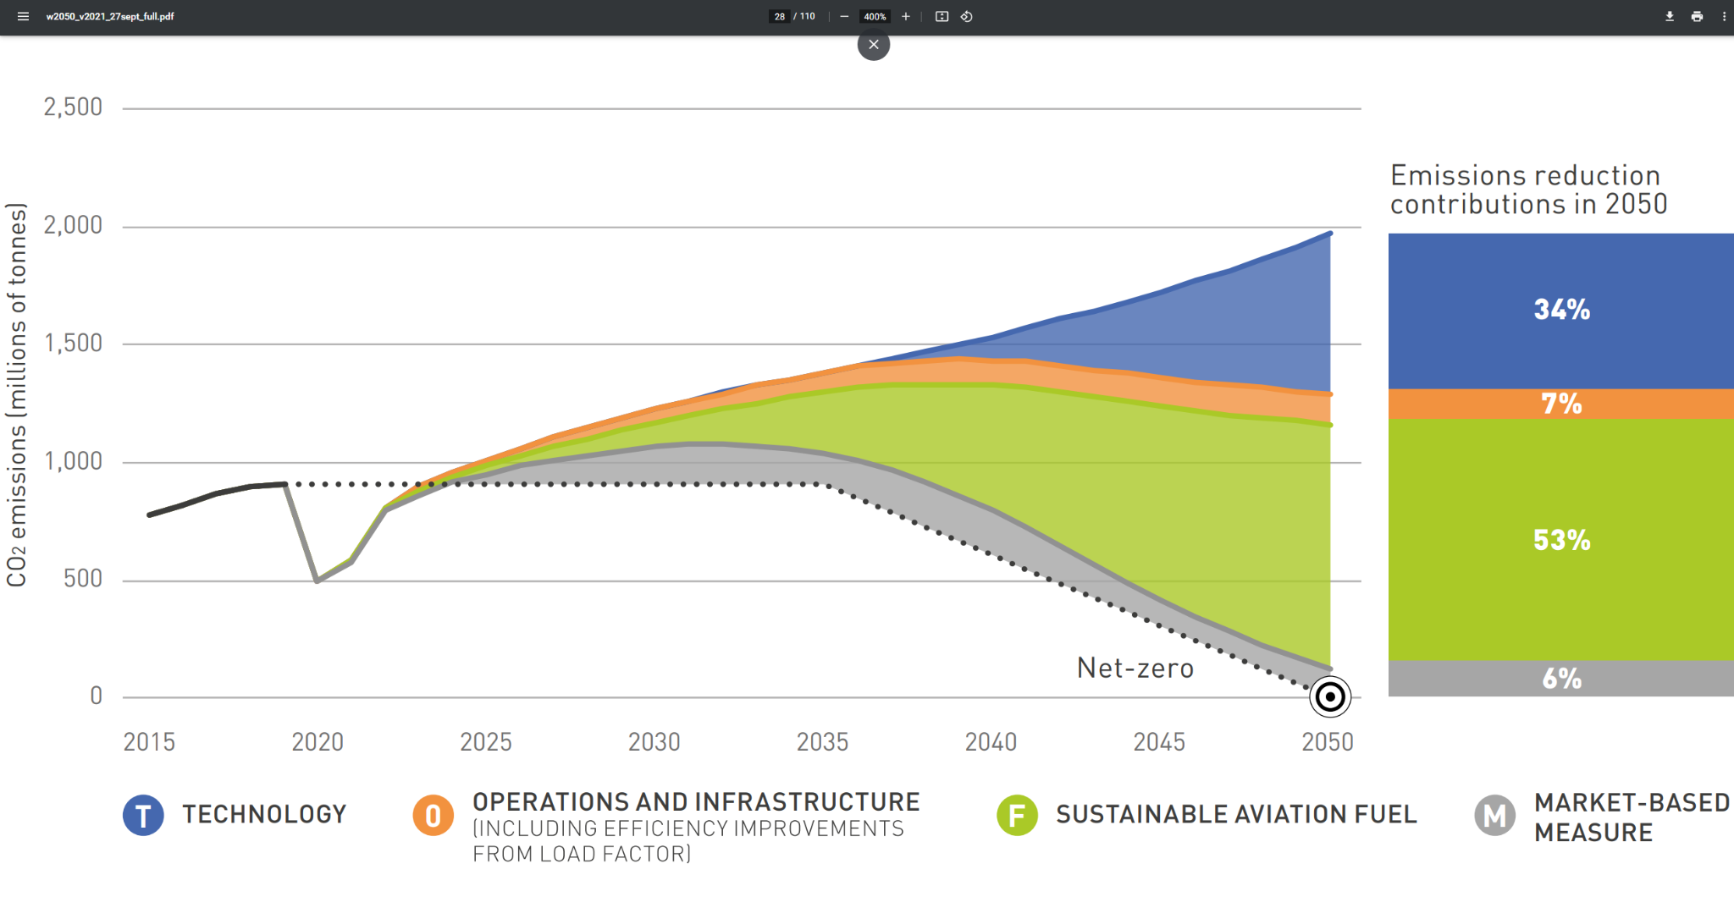
ZEROe Aircraft
Airbus Ambition
At Airbus, our ambition is to lead the decarbonisation of our sector and build the world’s first powered hydrogen aircraft by 2035.
Decarbonisation of aviation by 2050
Hydrogen combustion: generating thrust by burning liquid hydrogen
Hydrogen fuel cells: converting energy stored in H₂ into electrical energy to power electric motors
Synthetic fuels:
using a net-zero carbon fuel derived from renewable hydrogen & CO2
Notes:
On technology: Research and innovation funding programmes such as Horizon Europe--particularly as Horizon Europe ends in 2027.
On energy: The transition to decarbonised aviation relies on broad regulatory and production efforts made largely outside of our industry. This is why Airbus seeks to collaborate with stakeholders in other mobility sectors, energy providers and why actively participate in organisations such as Hydrogen Europe.
On regulation: The Hydrogen Bank is a promising first step, however, current guidance on how the Bank operates does not provide any specific support to mobility, which should be a priority for this type of mechanism. Also, the Bank's ultimate success will depend on the speed at which Europe can finalize the regulatory parameters for the production and consumption of hydrogen.
On infrastructure: Airbus collaborates with airports that are planning a stepped approach including using hydrogen to decarbonise all airport-associated ground transport (heavy goods logistics, buses, tow trucks) in the 2020 to 2030 timeframe. This will pave the way to hydrogen availability for aircraft in the 2030 timeframe. Airbus is committed to pursue the best applicable global technology.

Slide 4
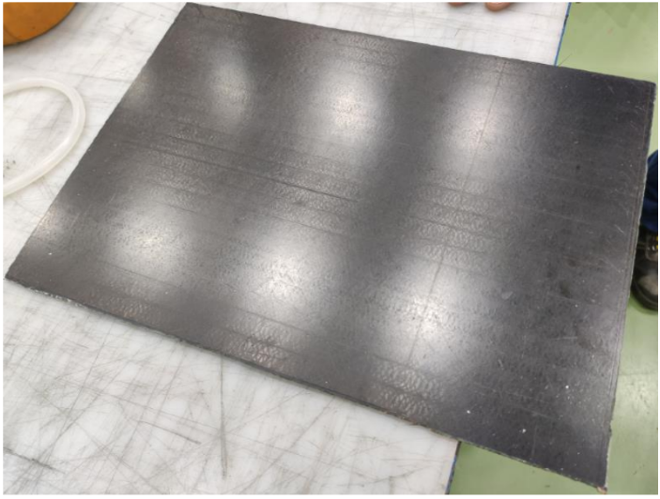
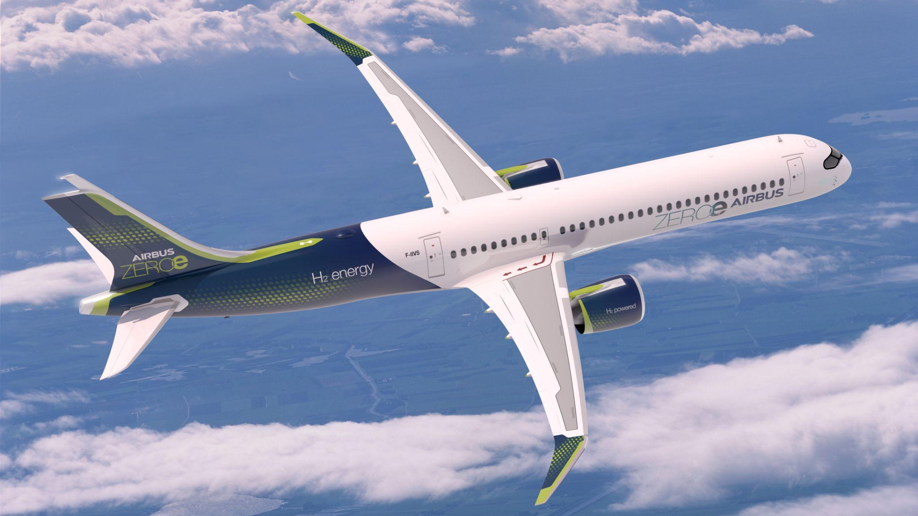
ZEROe Development Centres
Stade & Spain: Cured thin ply coupon panel with "cryo-capable" material
Stade & Spain: CFRP tank components DMU
Mission
Secure internal manufacturing capability to enable major program milestones including TRL6, MRL6, ground testing and flight testing by program launch
Enable a consistent and integrated approach to MAKE capability development across multi site ZEDC network
Bremen
LH2 Tank and dist. Systems
Filton
H2 Fuel system testing
Equipped Wings (ambition)
Nantes
LH2 Tank and dist. Systems
Getafe / Illescas
TTMS, CFRP tank & Rear End Fuselage PIA
CRFP Tank dev
Toulouse
Thrust module/PPS integration

Slide 5
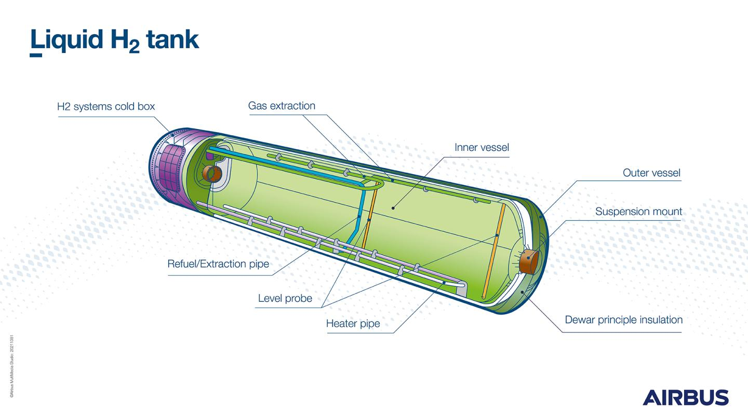
ZEDC - Industrial Roadmap
Concept selection (TRL3)
Product definition Feasibility demonstration industrial System Maturation
Product selection (TRL5-6) Product Design
Entry Into Service
Starting point
2020
2023/24
2026/27
2035
Product co-development
Transfer to Serial Production Facilities & Supply Chains
Manufacturing Process development
ZEDC Planning
ZEDC Start of Production
LH2 Tanks - Cryogenic storage & distribution
With contribution and support

Slide 6
H2C Flight Demonstrator

Slide 7
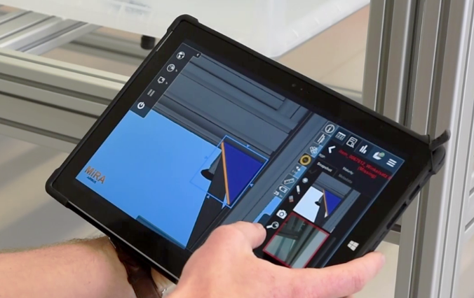
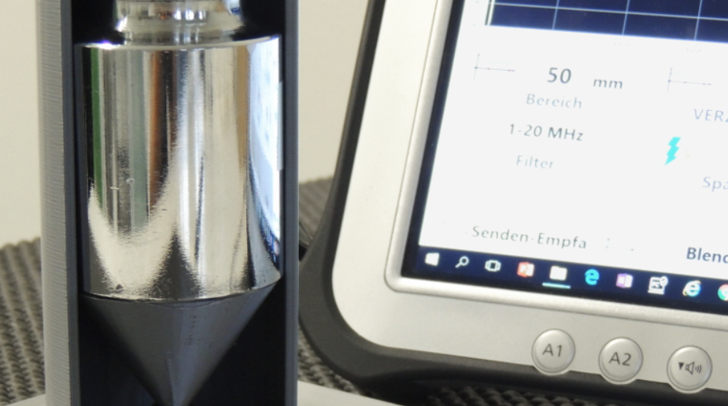
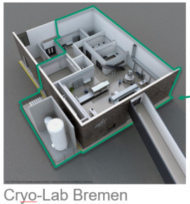
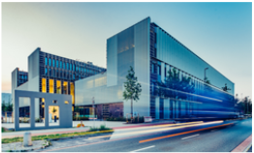
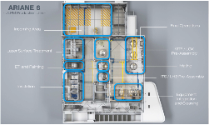
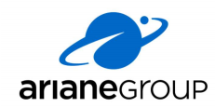
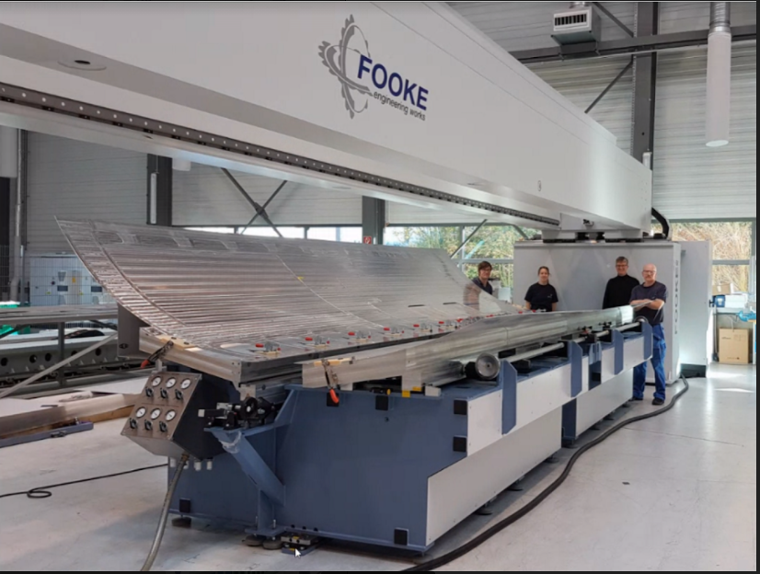
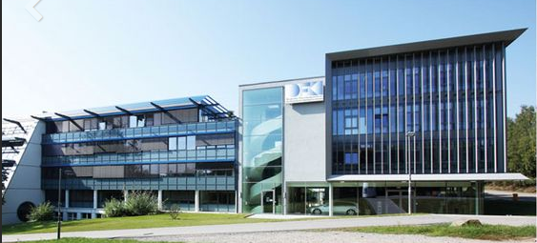
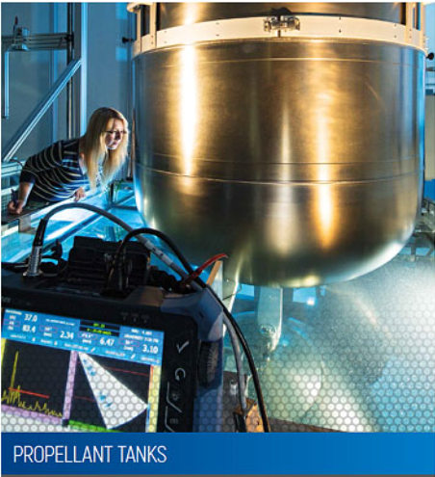
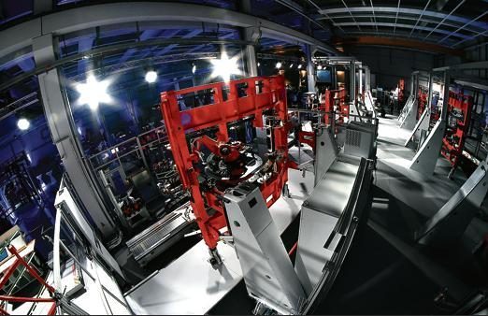
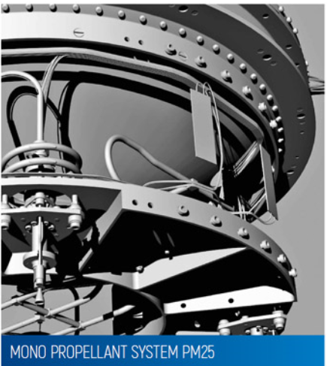
ZEDC Chamber of Reference - Ecosystem Bremen
Institute for Space Systems
CoC for system engineering, system design, system integration and system
testing
TESTIA
NDT & Quality Inspection
Trainings
30km
EcoMat
Technology Development & Testing
Ariane 6
Upper Stage Rocket Factory
Trauen
Orbital Propulsion Center
PAG
Stretch Forming
Friction Stir Welding
German Institute for AI
Robotic Innovation Center

Slide 8
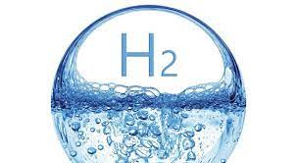
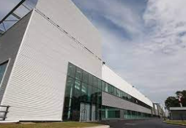
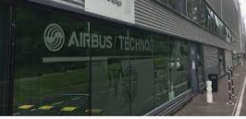
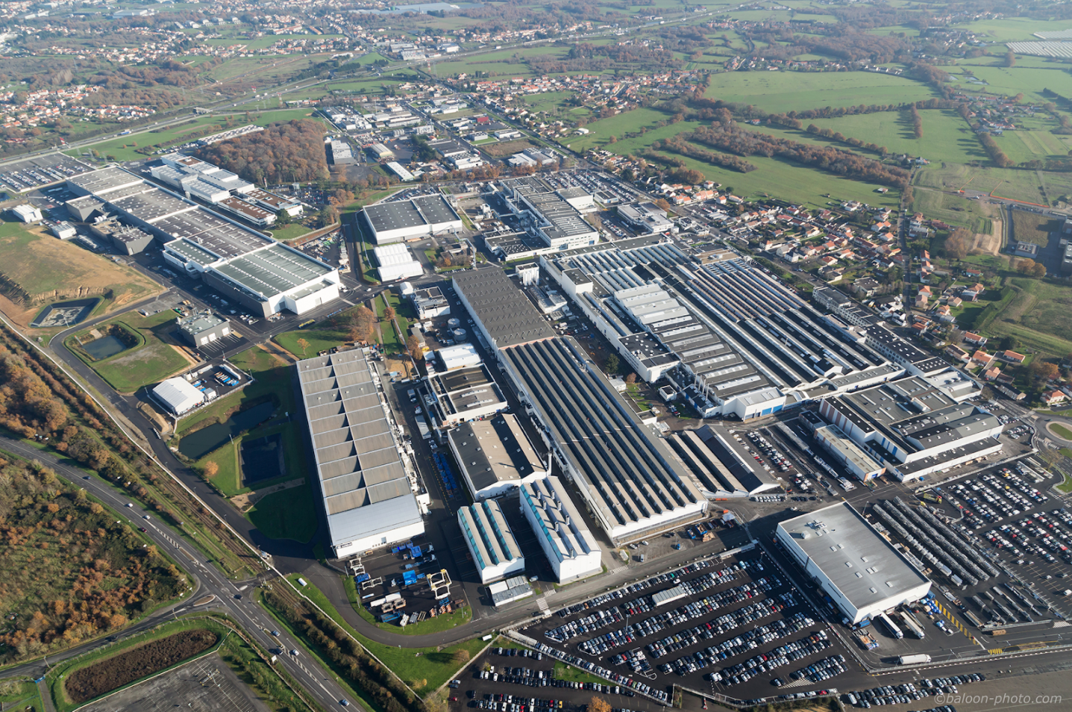
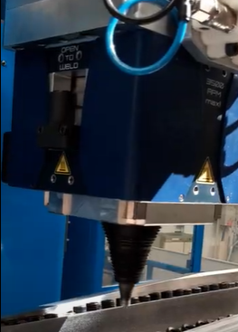
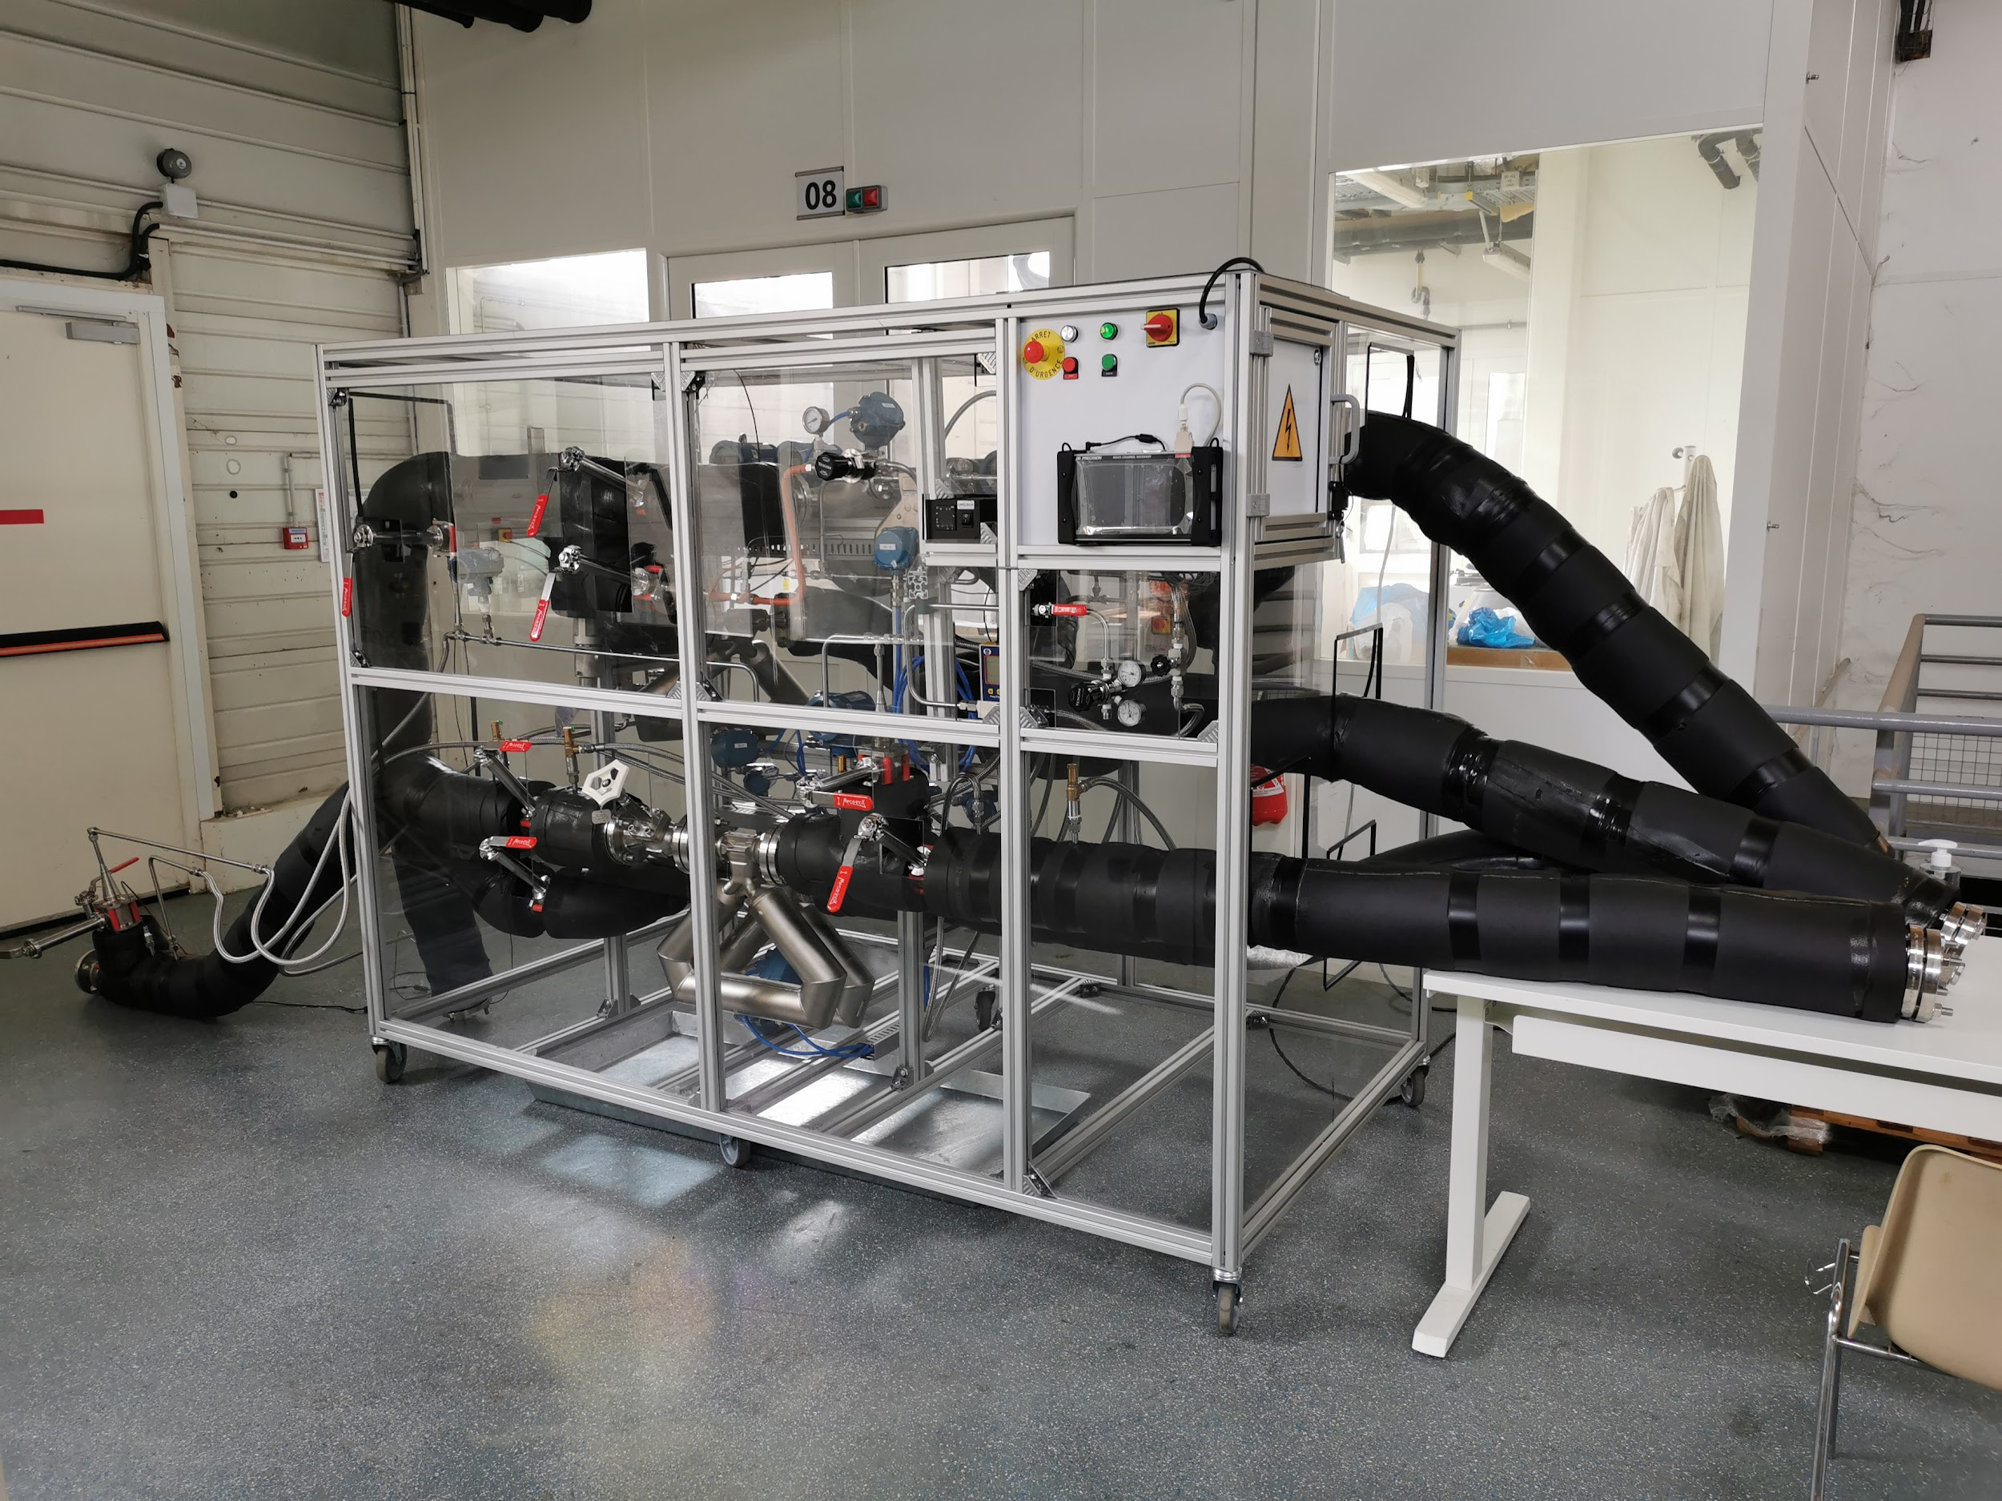
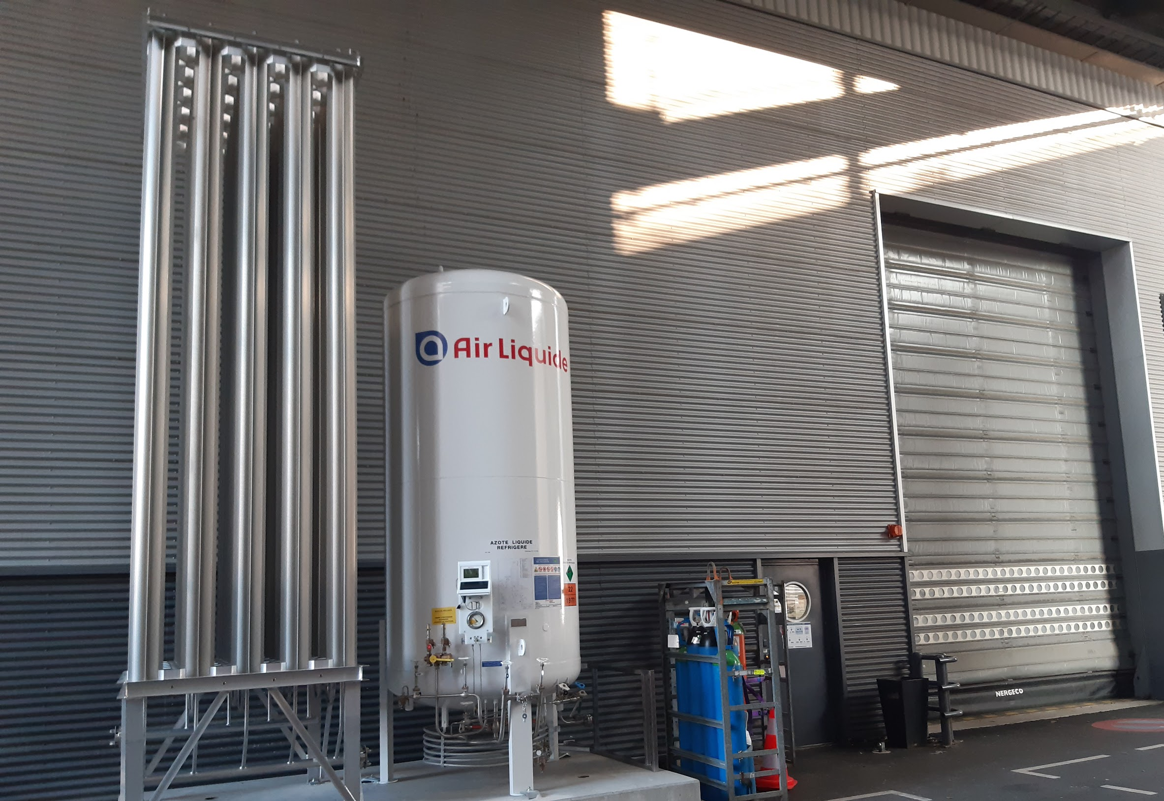
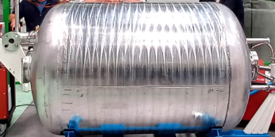
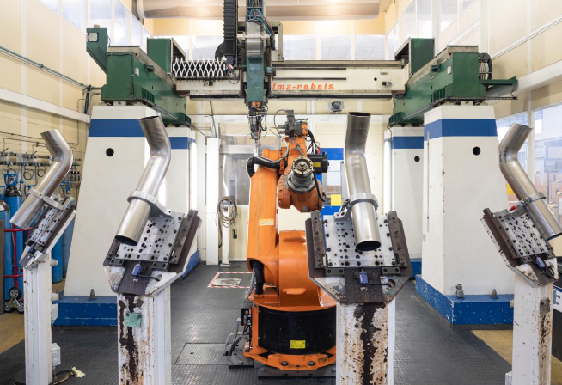
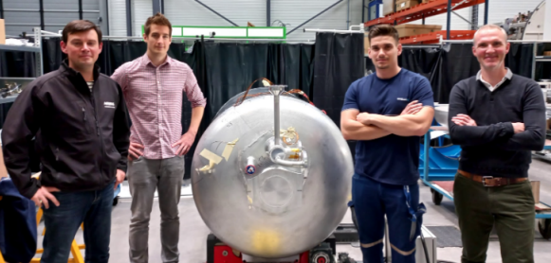
Capitalizing on available industrialization and manufacturing skills, infrastructure, services, and supply chains
ZEDC - Airbus Atlantic Nantes Ecosystem
TechnoCampus Composites
Development & Testing
Airbus Atlantic Nantes
A reliable, competitive, and innovative solution provider, strong on three pillars : metallic, composite, and integration.
TechnoCentre
FSW
Means & Skills
ZEDC
Cryogenic Bench
Physical Lab to operate LN2
Internal & External cooperation within highly skilled west eco-system
NDT & Quality
Inspection & Trainings
Pays de la Loire
Dynamics and Support
Airbus Atlantic St-Nazaire
High Welding Skills
Pipe bending
NDT & Quality Inspection

Slide 9
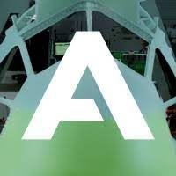
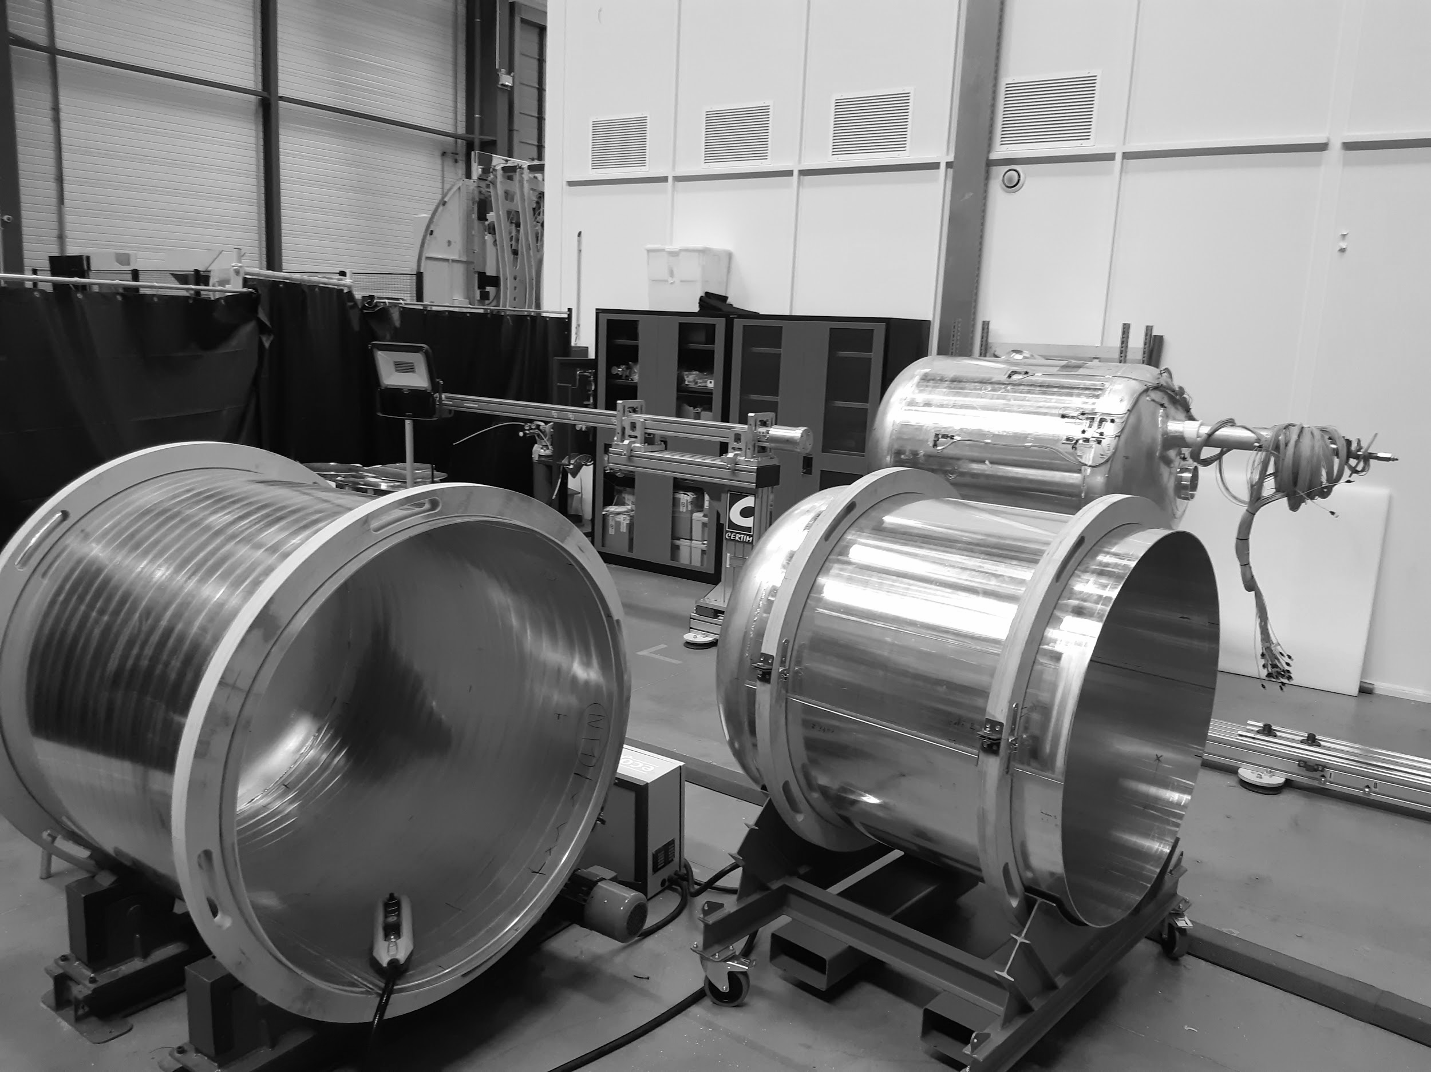
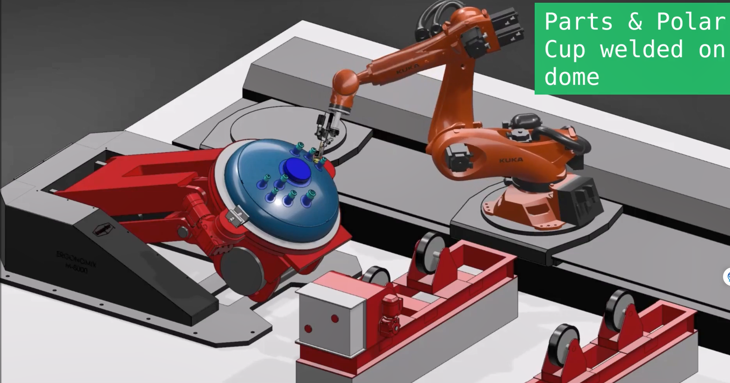
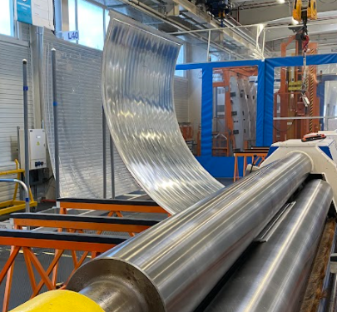
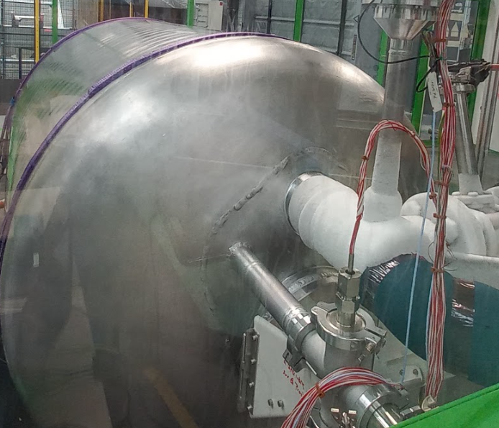
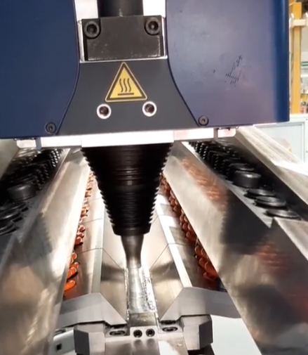
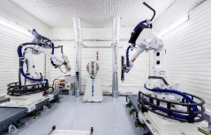
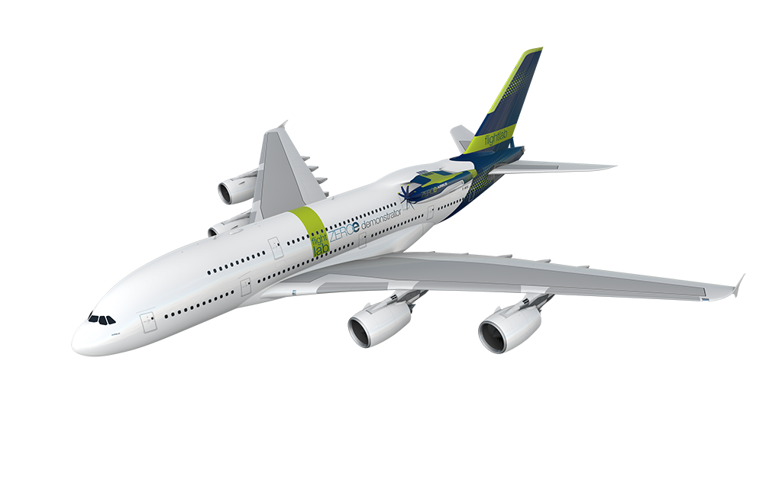
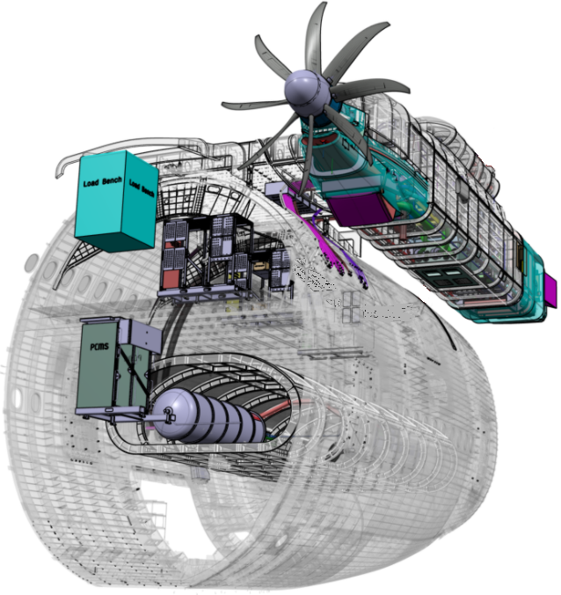
Airbus Atlantic Nantes with “Pays de la Loire” region sponsor
H2
Manufacture 1st Cryo “Fast Make Tanks” by Airbus
Layout ZEDC (ZEROe Development Centre)
The 1st "Fast Make" Tanks are technology accelerators and skills development on:
- Welding (FSW, TIG)
- Insulation & Vacuum production
- Pressure and leak tests
- Cryogenic tests (optimization of design and insulation solutions).
The ZEDC aims to :
- securing “CORE” techno
on LH2 storage (S2/MRL6)
- produce the LH2 tanks for the H2C flight demonstrator
- develop an efficient industrial system, resilient to architectural changes. This system is an ambition shared with the Bremen site.
Support “H2 Flight Demonstrator”
Develop ZEROe Ecosystem in Pays de La Loire Region
A380 (MSN1) will be the first Airbus to carry a hydrogen propulsion system.
The Technocentre develops and manufactures several major components of this flying laboratory: S1 H2C tanks, Support structure for the 4 H2 tanks (tent), Recovery structure between the fuselage and the engine (stub), and central structure of the nacelle (pod).
The LH2 Aeronautics ecosystem is gradually being structured around major industrial players, research institutes, university centers and institutions. It is up to us to build the framework for a sustainable whole of aviation.

Slide 10
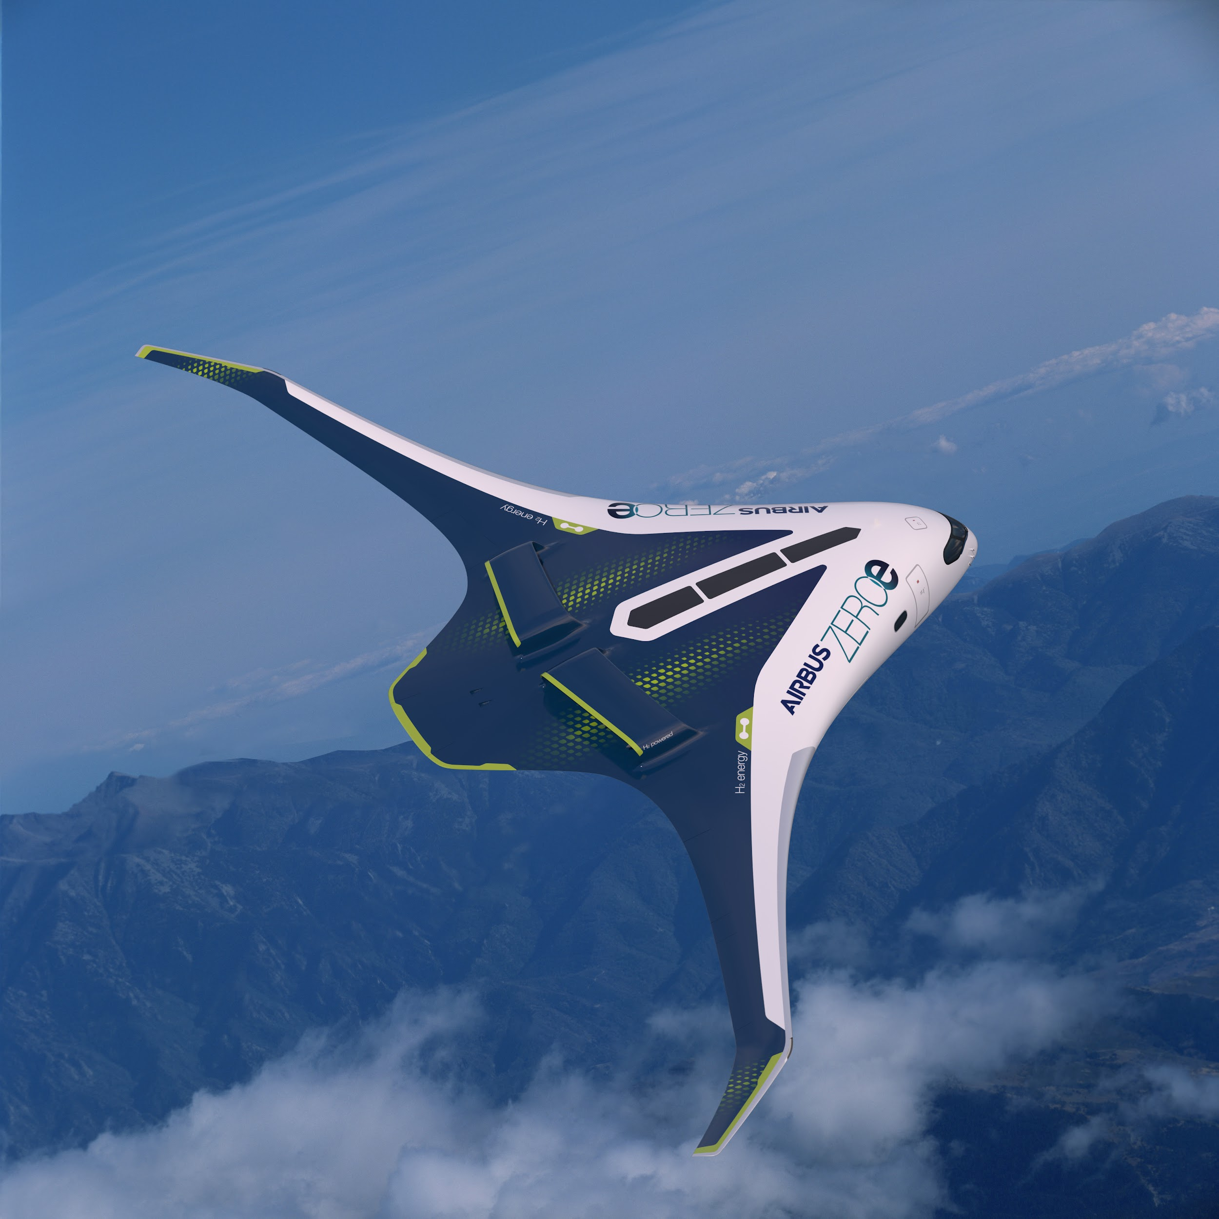
Thanks for your attention
Enjoy your 1st hydrogen flight !

