Slide 1
IT’S TIME TO BOOST HYDROGEN
THIS DOCUMENT AND ITS CONTENTS ARE PROPERTY OF ARIANEGROUP.
IT SHALL NOT BE COMMUNICATED TO ANY THIRD PARTY WITHOUT THE OWNER’S
WRITTEN CONSENT | ARIANEGROUP GMBH – ALL RIGHTS RESERVED.
-

Slide 2
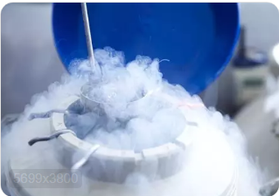
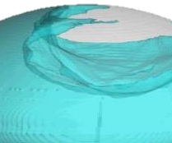
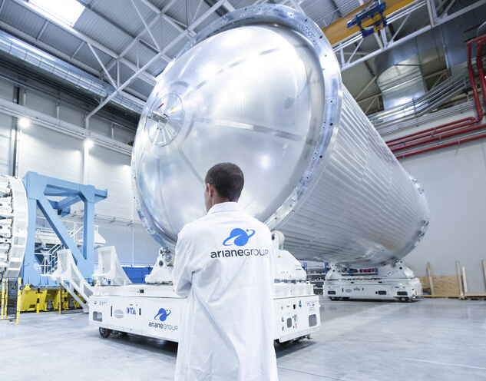
WE UNDERSTAND THE hydrogen CHALLENGES Especially with liquid hydrogen
High energy density
Cryogenic (-253°C)
Sloshing & thermo-dynamic control
Small molecule, low density → large, tight & insulated cryogenic tanks
Thermal conditioning and tight transport
Combustion and transformation into mechanical power
Cryogenic equipment
THIS DOCUMENT AND ITS CONTENTS ARE PROPERTY OF ARIANEGROUP.
IT SHALL NOT BE COMMUNICATED TO ANY THIRD PARTY WITHOUT THE OWNER’S
WRITTEN CONSENT | ARIANEGROUP GMBH – ALL RIGHTS RESERVED.

Slide 3
ARIANEGROUP: ACCELERATING THE TRANSFER to heavy mobility and the associated infrastructures
Space is not the limit
THIS DOCUMENT AND ITS CONTENTS ARE PROPERTY OF ARIANEGROUP.
IT SHALL NOT BE COMMUNICATED TO ANY THIRD PARTY WITHOUT THE OWNER’S
WRITTEN CONSENT | ARIANEGROUP GMBH – ALL RIGHTS RESERVED.
-

Slide 4
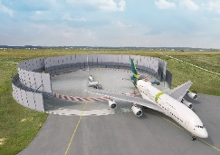
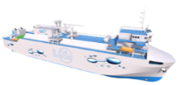
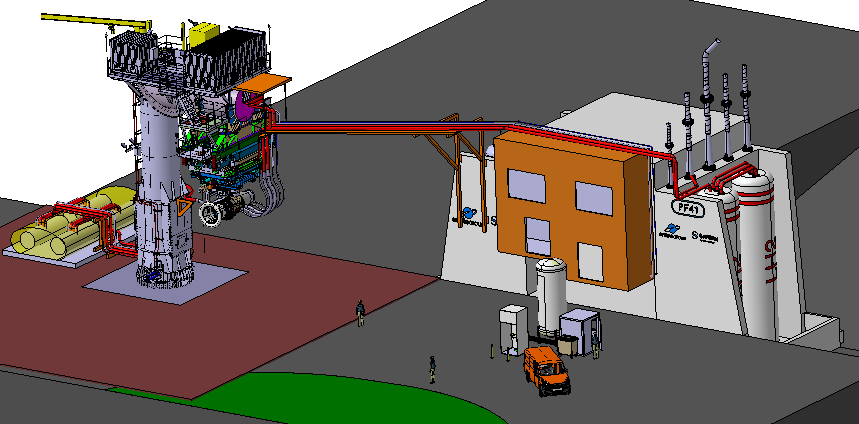
ArianeGroup: A unique know-how in liquid hydrogen
An End-To-End system knowhow along the complete hydrogen value chain
Competencies transferable from Space
Safety
Ground infrastructures Equipment & Subsystem Services & Engineering
Ground infrastructures Equipments & Subsystems Services & Engineering
Development of infrastructures for the management of GH2 and LH2
Adaptation of equipment developed for space to heavy mobility
Hydrogen tests
(test benches and areas) for heavy mobility
Development of infrastructures for the management of GH2 and LH2
Adaptation of equipment developed for space to heavy mobility
Hydrogen tests and material characterization
for heavy mobility and engineering activities
eg. adaptation of H2 test benches for preparation of ZEROe Flight Test Demonstration

Slide 5
Arianegoup COMPETENCIES in Heavy mobility
* as fuel
** as transport
Aeronautic
Oil & Gas (H2 supply chain) + Miscellaneous
Infrastructures
Tests for equipment and sub-systems, Material characterization, Engineering support, training, Expert/Audit
Maritime, Train & Automotive
Services
Equipments & sub-systems
Bunkering**, liquefier, LH2 storage terminal
Bunkering *, Hydrogen Refueling System, Test benches
Pump, Coupling, Tank, Heat Exchanger, Valves, Fluid & Gas compressor/circulator
Pump, Valves, Gas compressor, Cryo expander
Domains
THIS DOCUMENT AND ITS CONTENTS ARE PROPERTY OF ARIANEGROUP.
IT SHALL NOT BE COMMUNICATED TO ANY THIRD PARTY WITHOUT THE OWNER’S
WRITTEN CONSENT | ARIANEGROUP GMBH – ALL RIGHTS RESERVED.

Slide 6
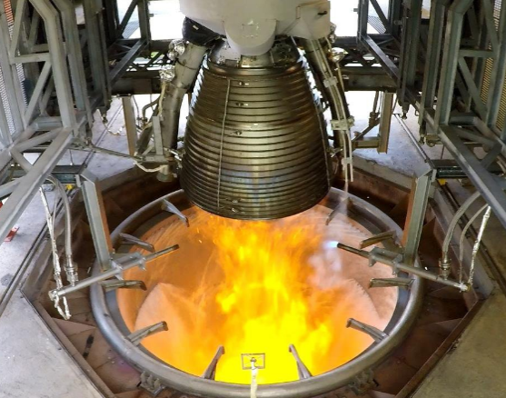
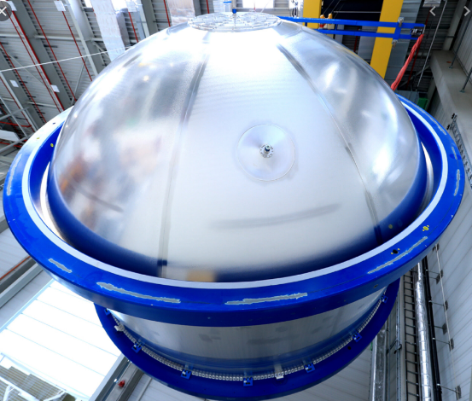
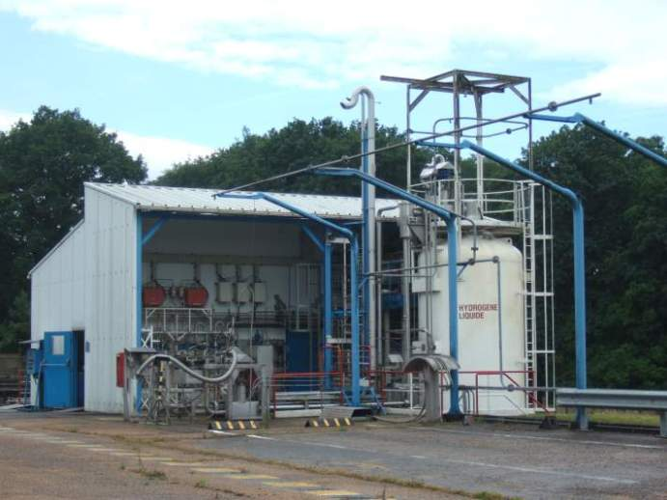
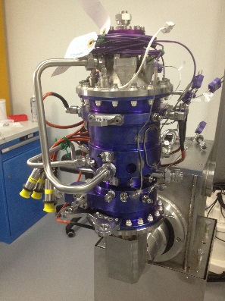
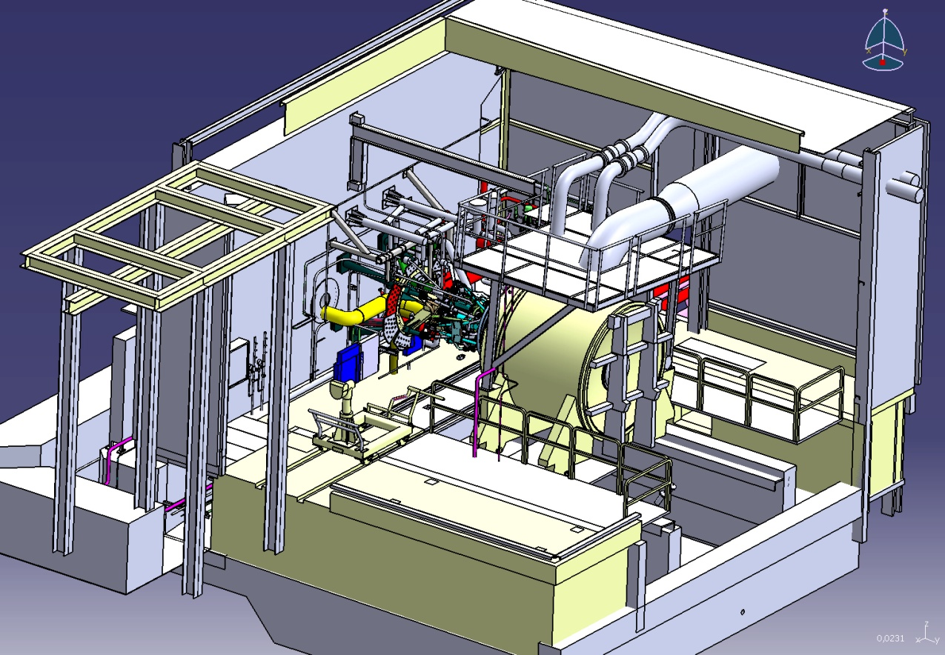
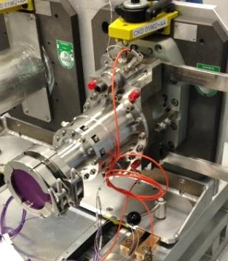
World leader in hydrogen mobility since 50 years
50 YEARS OF ARIANE SUCCESS RELY ON LIQUID HYDROGEN PROPULSIVE SYSTEMS, STAGES & INFRASTRUCTURES
MAKING (LIQUID) HYDROGEN ACCESSIBLE AND SAFE TO ENABLE ENERGY TRANSITION ACROSS INDUSTRIES IS OUR AMBITION
PROPULSION SYSTEMS
2900MW: VULCAIN’s POWER IS EQUIVALENT TO A LARGE ELECTRIC PLANT
TANKS
30T OF LH2 EMBARKED ON EACH ARIANE 6 FLIGHT
TEST CENTER
ARIANEGROUP IS OPERATOR OF THE LARGEST HYDROGEN TEST FACILITY IN EUROPE
EQUIPMENT
FULL SET OF LH2-PROVEN EQUIPMENT & MATERIALS
GROUND INFRASTRUCTURES
DESIGN & OPERATION OF TURNKEY FACILITIES
TRAINING & SAFETY
1500+ EMPLOYEES QUALIFIED ON HYDROGEN
AnticipATING

Slide 7
Marco Gosch
Program Manager Hydrogen and Upper Stage
T: +49 421 4372 4173
marco.gosch@ariane.group
Marie-Sophie Nizou
Hydrogen Program Manager and Business Developer
T : +49 (0)421 4372 3057
marie-sophie.nizou@ariane.group
ArianeGroup
Airbus Allee 1
28199 Bremen
THIS DOCUMENT AND ITS CONTENTS ARE PROPERTY OF ARIANEGROUP.
IT SHALL NOT BE COMMUNICATED TO ANY THIRD PARTY WITHOUT THE OWNER’S
WRITTEN CONSENT | ARIANEGROUP GMBH – ALL RIGHTS RESERVED.
-

