Slide 1
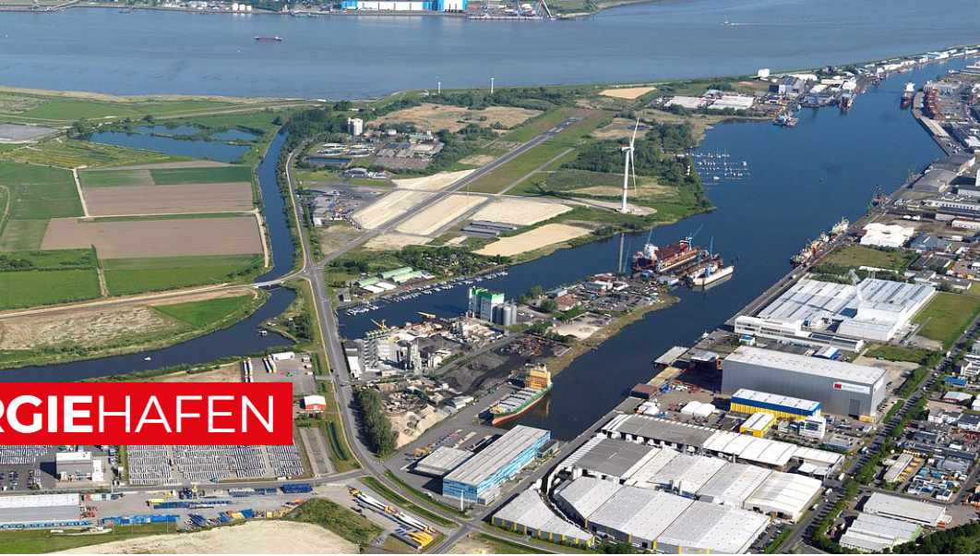

Bremerhaven‘s
Energy Port

Slide 2

CENTRE OF THE ENERGY TRANSITION
ENERGY PORT BREMERHAVEN
TARGET
Germany has set itself the target of becoming as independent as possible in terms of energy supply and banks on renewable energy in order to mitigate climate change.
However efficient ports are needed to meet this target. Thus, the EnergyPort in Bremerhaven is of national importance.
© bremenports

Slide 3

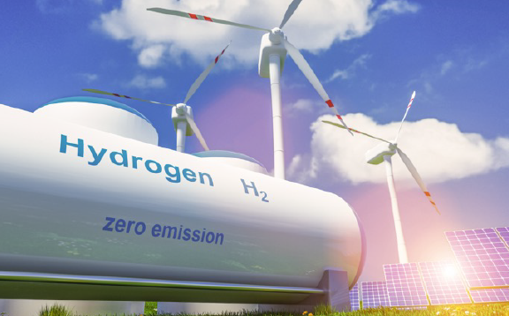
ENERGY PORT BREMERHAVEN
The port as energy hub
Since the German domestic production potential for green hydrogen is limited, the National Hydrogen Strategy envisages a permanent import of 50-70% of the demand in 2030, which is to be mainly ship-based. Even if the pipeline share is likely to increase after 2030, ship-based imports should be retained for reasons of risk minimization.
The ports of Bremen are already preparing for this role as energy hub especially in the following sectors
Hydrogen import
CO2 export
Support for offshore wind power generation
Two fundamental research studies have been carried out in 2022 to clarify how the ports of Bremen und Bremerhaven can contribute to climate-neutral energy security in future.
NO PORTS – NO ENERGY – NO INDUSTRY
Port for climate-neutral
energy security
Quelle: Bosch
© bremenports

Slide 4

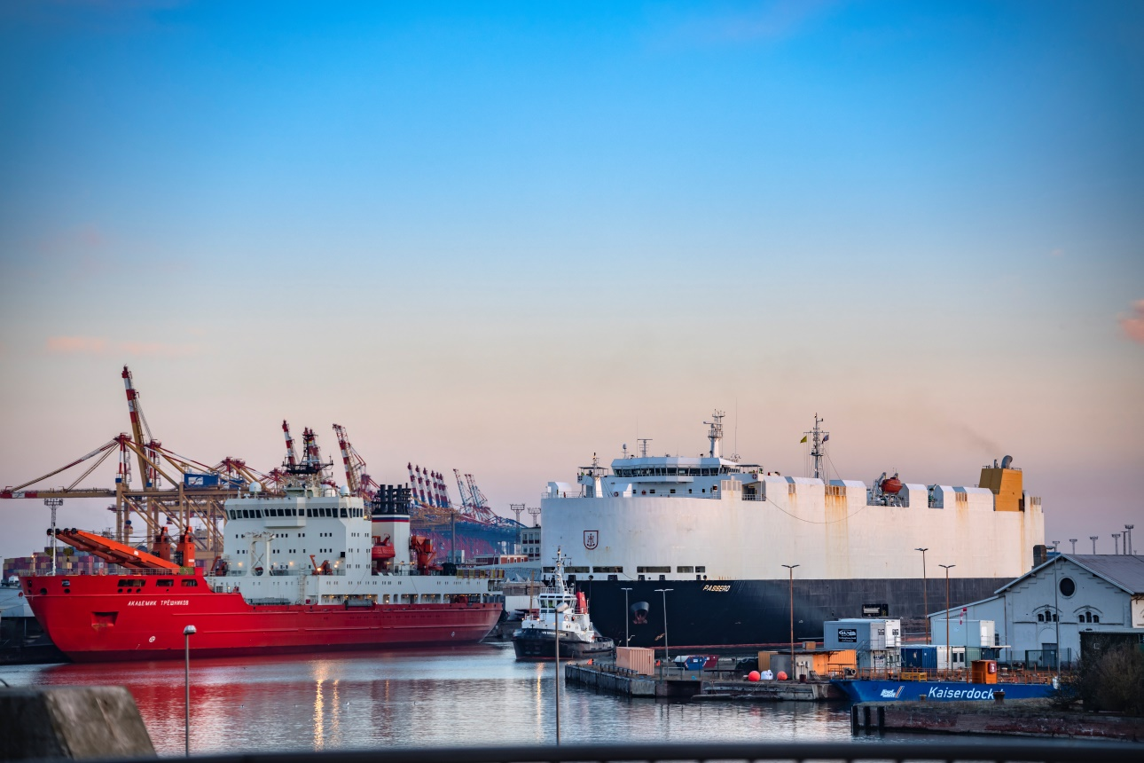



PREPARING
FOR THE FUTURE NOW
hydrogen economy development opportunities
fishery-port capability study
We have launched a large number of projects to ensure that the ports of Bremen are prepared for the future.
sH2UNTER

Slide 5

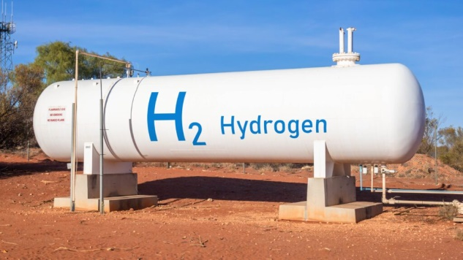

Hydrogen economy development opportunities - Round up - general requirements
Fundamental points of action
Pipeline connection to hydrogen backbone / storage caverns
Transhipment facilities, import and storage
Bunker facilities / refuelling stations
Regasification plant
Loading facilities for tank trucks, tank wagons and potentially tanker vessels / barges
Establishment of green transport corridors
Process heat circuits
Local production of various PtX fuels
CO₂ transhipment terminal linked with local e-fuel production
Supply of green energy
Source: ChemieXtra
© bremenports

Slide 6

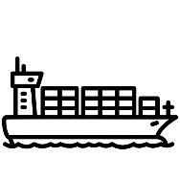










Hydrogen economy development opportunities
Energy future at the ports of Bremen and Bremerhaven
CGH₂
Regional & National supply
Import terminal for hydrogen & hydrogen derivatives
H2 pipelines, inland waterway, rail & road transport chains
Closing gap by connecting pipeline to European hydrogen backbone
Green-fuel production for shipping and aviation
Bunker terminals for marine shipping (e.g. methanol)
Export terminals for CO₂ from carbon capture
CGH₂
Small-scale consumers
BHV
CGH₂
LOHC/CGH₂/LH₂
HH
CGH₂/LH₂
Regional caverns
HB
CGH₂ (pipeline)
Airport
Steel production
B,
NL
SZ
European Hydrogen Backbone
© bremenports

Slide 7
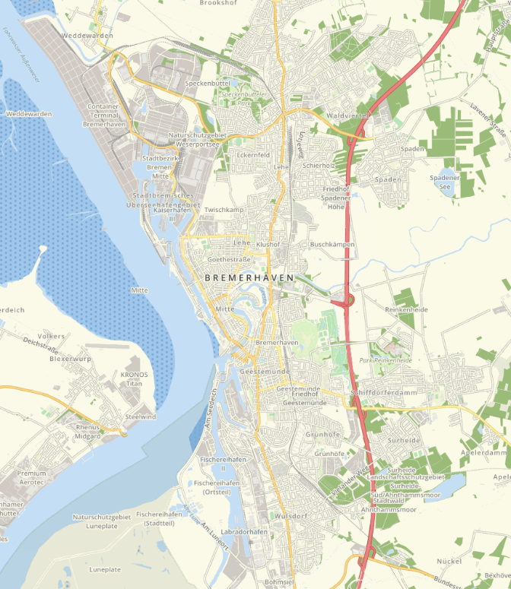
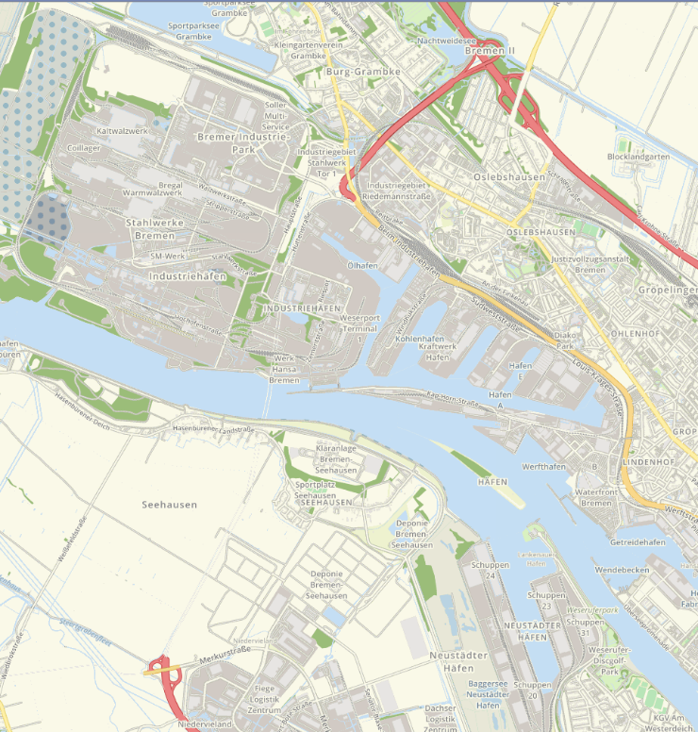
Hydrogen economy development opportunities
Location-options for import via the ports of Bremen and Bremerhaven
Container terminal: CGH₂ (pressurised containers)
Columbus Quay:
CGH₂ (tanker), LH₂, synthetic methanol, LOHC
Industriehäfen: CGH₂ (tanker), LH₂
Osterort:
CGH₂ (tanker), LH₂, synthetic methanol, LOHC
Weserbogen:
CGH₂ (tanker), LH₂, synthetic methanol, LOHC
Fischereihafen:
synthetic methanol, LOHC
Bremerhaven **
Bremen **
*subject to agreement with local business enterprises
**rated as primary area of action.
© bremenports

Slide 8
PREPARING
FOR THE FUTURE NOW
hydrogen economy development opportunities
fishery-port capability study
We have launched a large number of projects to ensure that the ports of Bremen are prepared for the future.
sH2UNTER

Slide 9
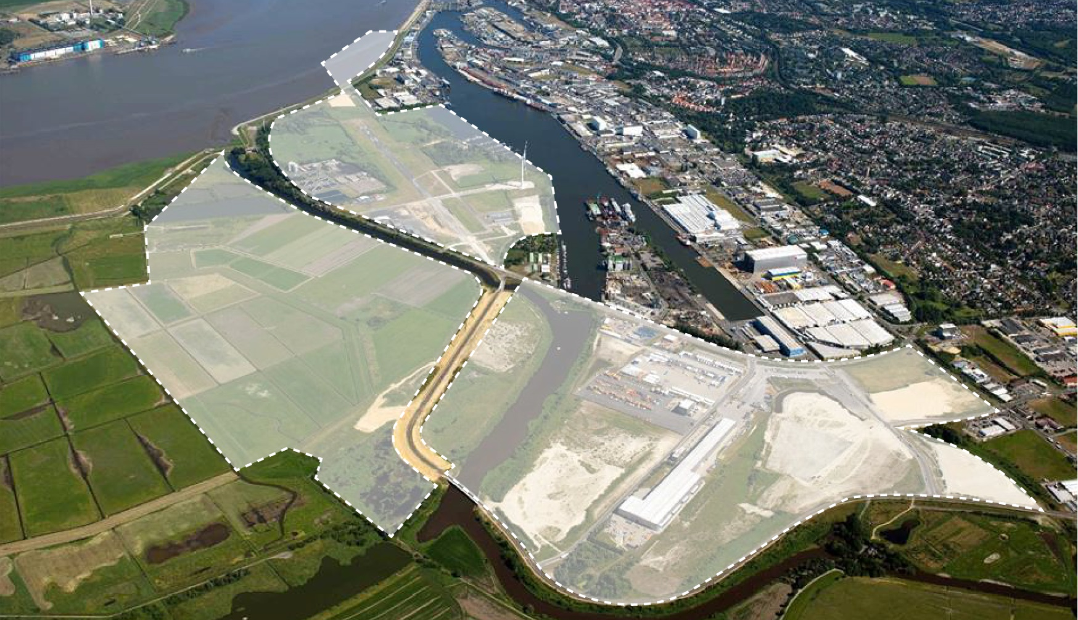
Capability study for the southern fishery-port in Bremerhaven
Development area in Bremerhaven’s south
Western fishery-port
134 ha
Lune Delta 94 ha
Luneort/ Reithufer
38 ha
© bremenports

Slide 10
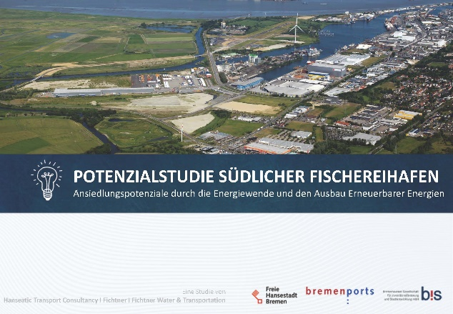
Capability study for the southern fishery-port in Bremerhaven
Potential for attracting new businesses owing to the transition to green energy and the promotion of renewable energies
Eco-friendly generation, storage and distribution of energy: production, manufacturing, transhipment and storage of components for offshore wind farms, research & development in the field of H2 production
Sustainable mobility: lithium and battery production, manufacturing of utility vehicles with climate-neutral drive systems, fuel cell production
Circular economy: recycling of different substances and materials, e. g. batteries (lithium, cobalt, nickel etc.), metals, wind turbines as well as small and medium-sized ships
Energy import: transshipment, storage and on-site processing of hydrogen and derivatives for local and national use
CO₂
Perspectively: transhipment and storage of CO₂ for export and methanol production
© bremenports

Slide 11
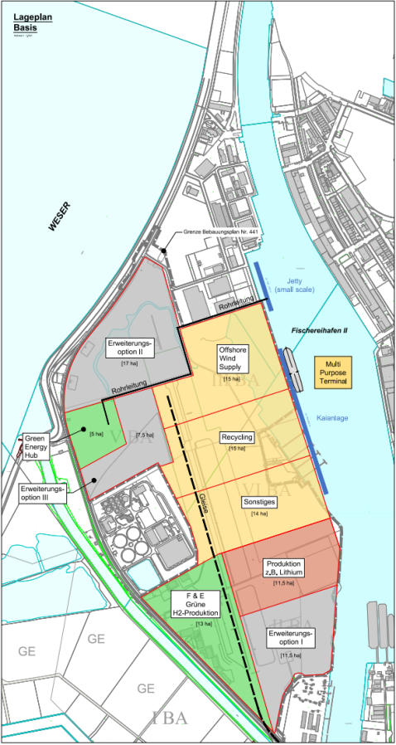
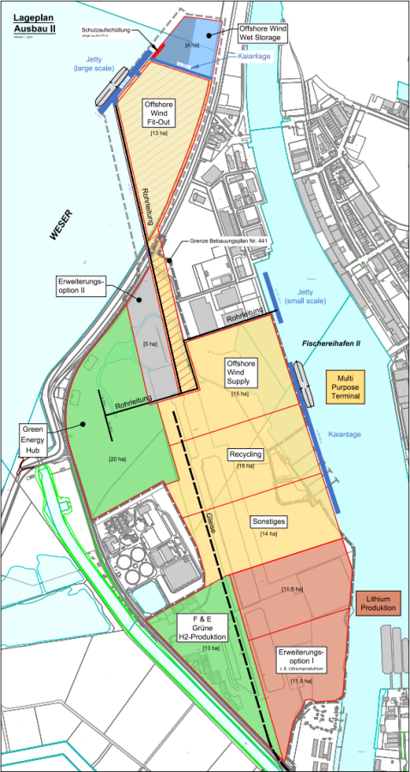
Capability study for the southern fishery-port
Proposed future development scenarios for the Fishery-port area
Basic layout
Expansion layout
Area usage:
Energy
Logistics
Production
Development
landside infrastructure waterside infrastructure
pipeline quay / jetty
rail tracks
NB: modular construction, no mandatory chronological order, combination and independent development of the different layouts are possible
© bremenports

Slide 12
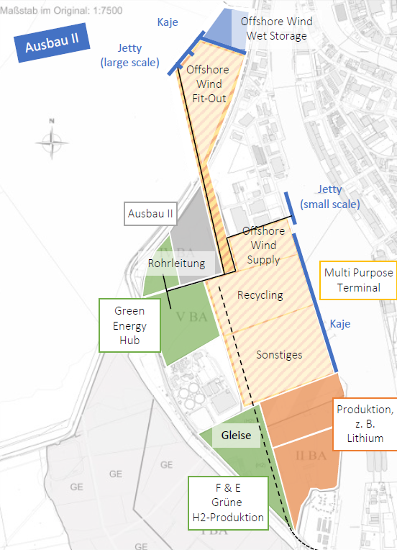
Capability study for the southern fishery-port
The energy transition offers the potential to attract new businesses
FACT CHECK
The expansion layout combines servicing the needs of the offshore wind industry with these of hydrogen import
Technical requirements within the port : Quay – approx. 600m small scale jetty – approx. 200 m Increased water depth
Technical requirements alongside River Weser: Quay – approx. 250m With connected wet storage area Jetty – approx. 300 m
Layout as basis for several possible solutions
Start of in-depth examination in July 2023
© bremenports

Slide 13
PREPARING
FOR THE FUTURE NOW
hydrogen economy development opportunities
fishery-port capability study
We have launched a large number of projects to ensure that the ports of Bremen are prepared for the future.
sH2UNTER

Slide 14
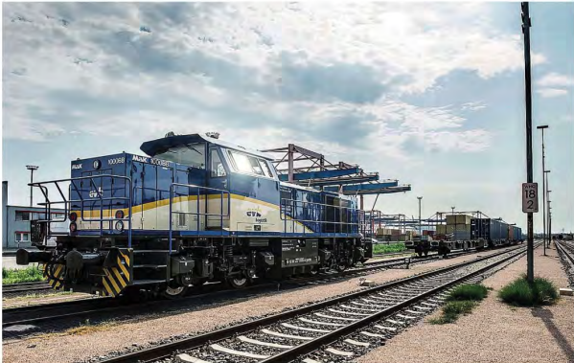







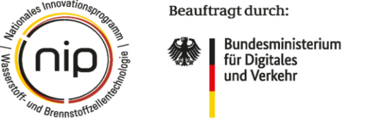

© bremenports

Slide 15
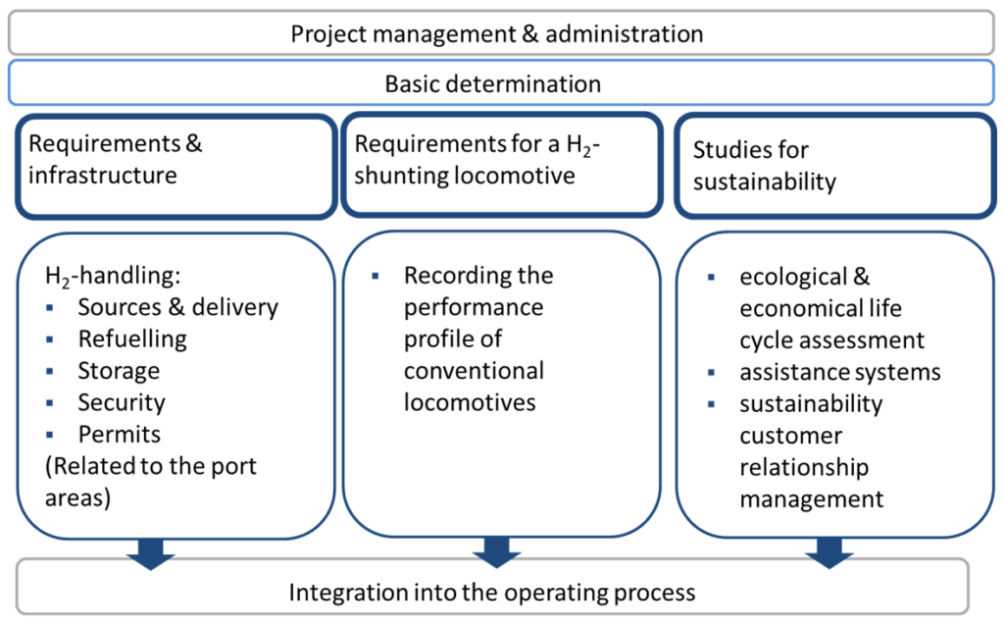

Project sH2UNTER
Clarification of requirements for operating shunting locomotives with hydrogen in the ports of Bremen and Hamburg
© bremenports

